Slide 1
MONTE CARLO TESTING AND VERIFICATION OF NUMERICAL ALGORITHM IMPLEMENTATIONS
David D. Pokrajac
Abdullah-Al-Zubaer Imran
Predrag R. Bakic

Slide 2
OUTLINES
Objectives
Validation
Monte Carlo Approach
Numerical Algorithms Validation
Software Testing
Software Verification
Application in Partial Volume Approximation
Results
Discussion & Conclusions
Acknowledgements

Slide 3
PARTIAL VOLUME APPROXIMATION
π₁
Voxel V
n₂
V₁
Adipose tissue
n₁
π₂
x_{c}
x₁
x₂
Ligament-Adipose boundary
Skin
Cooper’s ligament

Slide 4
OBJECTIVES
To develop a statistical test in order to assess the correctness of a numerical algorithm implementation
To propose a Monte Carlo method of an approximation algorithm
To illustrate the methodology on partial volumes

Slide 5
VALIDATION
Software testing
Verification
Software testing determine whether the algorithm in quest is correctly implemented
Software verification comprises techniques determine the adequacy of the developed algorithm
Software testing by providing a limited set of test cases with known outputs
Difficulty to examine a variety of potential inputs to software
In software verification, it is often of interest to determine the accuracy of an approximation algorithm
Validation can be performed empirically

Slide 6
MONTE CARLO AS THE REPLACEMENT
The application of Monte Carlo approach for validation of a class of numerical software.
The method is developed for a class of multiple integral computation problems and demonstrated on a related problem of partial volume computation
A statistics developed and what shows:
→H0: algorithm implementation is correct
→The statistics has asymptotical standard normal distribution

Slide 7
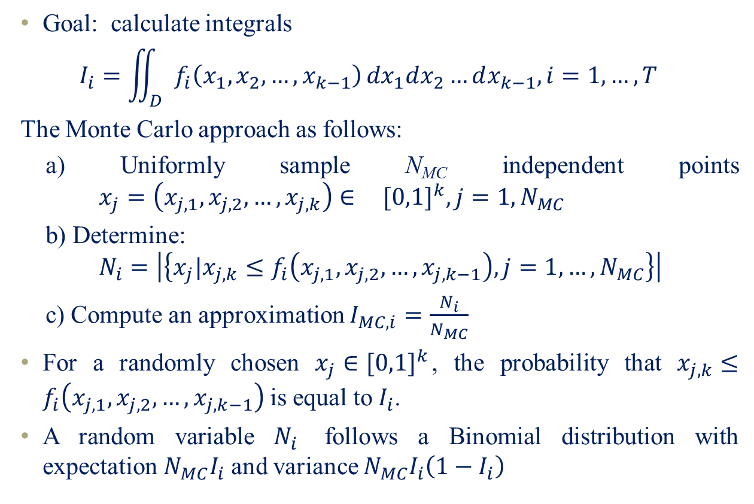
BASICS
Goal: calculate integrals
$$I_{i}=\iint_{D}{f_{i}\left(x_{1},x_{2},…,x_{k−1}\right)}{dx}_{1}dx_{2}…dx_{k−1},i=1,…,T$$
The Monte Carlo approach as follows:
a) Uniformly sample N_{MC} independent points $x_{j}=\left(x_{j,1},x_{j,2},…,x_{j,k}\right)∈{ [0,1]}^{k}, j=1{,N}_{MC}$
b) Determine: $N_{i}=\left|\left\{x_{j}|x_{j,k}≤f_{i}\left(x_{j,1},x_{j,2},…,x_{j,k−1}\right),j=1,…,N_{MC}\right\}\right|$
c) Compute an approximation $I_{MC,i}=\frac{N_{i}}{N_{MC}}$
For a randomly chosen $x_{j}∈{[0,1]}^{k}$, the probability that $x_{j,k}≤f_{i}\left(x_{j,1},x_{j,2},…,x_{j,k−1}\right)$is equal to $I_{i}$.
A random variable $N_{i}$ follows a Binomial distribution with expectation ${N_{MC}I}_{i}$ and variance ${N_{MC}I}_{i}\left({1−I}_{i}\right)$

Slide 8

SOFTWARE TESTING
Assume: $I_{a,i}=\iint_{D}{g_{i}\left(x_{1},x_{2},…,x_{k−1}\right)}{dx}_{1}dx_{2}…dx_{k−1}, i=1,…,T$ is implemented.
$g_{i}\left(x_{1},x_{2},…,x_{k−1}\right)=F\left(f_{i}\left(x_{1},x_{2},…,x_{k−1}\right)\right)$ are suitable chosen functions
Consider a set of functions f_{i} (i,…,T): the algorithm provides an exact solution
Under H₀ that the algorithm is correctly implemented, for large enough T, random variable Z has approximately Gaussian distribution
$Variance: σ_{X}^{2}+σ_{Y}^{2}−2σ_{XY}$(X and Y: Two random variables)
$Z^{∗}=\frac{Z}{s_{Z}^{}}$
$s_{Z}^{}=\sqrt{\frac{s^{2}\left(ε_{}^{2}\right)}{T}+\frac{{3s}^{2}\left(I_{a}\left(1−I_{a}\right)\right)}{T{N_{MC}}^{2}}}$
$$s\left(ε_{}^{2}\right)=\sqrt{\frac{1}{T−1}\sum_{i=1}^{T}{{\left(ε_{i}^{2}−\overline{ε_{}^{2}}\right)}^{2}}}$$
$$\overline{ε_{}^{2}}=\frac{1}{T}\sum_{i=1}^{T}{ε_{i}^{2}}$$

Slide 9
SOFTWARE VERIFICATION
A random variable $Z^{′}$defined as: $Z^{′}=X−Y^{′}$
$$=\frac{1}{T}\sum_{i=1}^{T}{ε_{i}^{2}}−\frac{1}{N_{MC}−1}\left(\frac{1}{T}\sum_{i=1}^{T}{I_{MC,i}\left(1−I_{MC,i}\right)}\right)$$
Z’, is asymptotically Gaussian, with mean equal to $E\left(ε_{A}^{2}\right)$ and variance which square root is bounded ${ \frac{1}{\sqrt{T}}\left|σ\left(ε^{2}\right)−\frac{σ\left(I_{MC}\left(1−I_{MC}\right)\right)}{N_{MC}−1}\right|≤σ}_{Z′}^{}≤\frac{1}{\sqrt{T}}\left(σ\left(ε^{2}\right)+ \frac{σ\left(I_{MC}\left(1−I_{MC}\right)\right)}{N_{MC}−1}\right)$
The boundaries for standard deviation of the estimate can be obtained when a squared root $σ$ of variance is estimated using a sample standard deviation s as:
$s_{Z′,min}^{}{≤s}_{Z′}^{}≤s_{Z′,max}^{}$,
$s_{Z′,min}^{}=\frac{1}{\sqrt{T}}\left|s\left(ε^{2}\right)−\frac{s\left(I_{MC}\left(1−I_{MC}\right)\right)}{N_{MC}−1}\right|$
${ s}_{Z′,max}^{}=\frac{1}{\sqrt{T}}\left(s\left(ε^{2}\right)+\frac{s\left(I_{MC}\left(1−I_{MC}\right)\right)}{N_{MC}−1}\right)$

Slide 10
PRACTICAL APPLICATION
Case | p₁ (6 bits) | p₂ (6 bits) | Label (4 bits)
1.Skin and air | 0 | p_{Air} | 0
2.Cooper’s ligament; fat | p_{Fat} | 0 | 1
3.Cooper’s ligament; dense | 0 | p_{Dense} | 1
4. Skin; dense tissue | 0 | p_{Skin} | 3
5. Skin; fat tissue | 0 | p_{Skin} | 2
6. Skin; Cooper’s ligament | 1-p_{Skin} | p_{Skin} | 2
7. Skin, Cooper’s ligament and dense tissue | p_{Cooper} | p_{Skin} | 3
8. Skin, Cooper’s ligament and fat tissue | p_{Cooper} | p_{Skin} | 2
5
6
4
1
3
7
7
8
2
8
Skin
Two-material ligament
Three-material ligament

Slide 11
RESULTS
Computed p-values for statistical test of algorithm for correct implementation of Partial Volume Algorithm obtained for different combinations of T and $N_{MC}$
T | 1e6 | 1e5 | 1e4 | 1e5 | 1e4 | 5e6 | 1e6 | 1e5
$$N_{MC}$$ | 1e5 | 1e5 | 1e5 | 1e4 | 1e4 | 10 | 10 | 10
p-value | 0.971 | 0.831 | 0.242 | 0.966 | 0.987 | 0.615 | 0.574 | 0.846

Slide 12
RESULTS (CONT’D)
Estimated approximation error (mean and standard deviation boundaries): $N_{MC}=63$. MSE_{A} from corresponding to Z’ is included for comparison
Voxels containing | T | $Z′$ | $s_{Z′,min}^{}$ | $s_{Z′,max}^{}$ | MSE_{A}
Skin | 1,597,042 | 1.952e-05 | 1.622e-06 | 3.927e-06 | 2.01e-05
Ligaments and Compartmental Tissue | 6,435,881 | 4.330e-04 | 1.191e-06 | 2.368e-06 | 4.32e-04

Slide 13
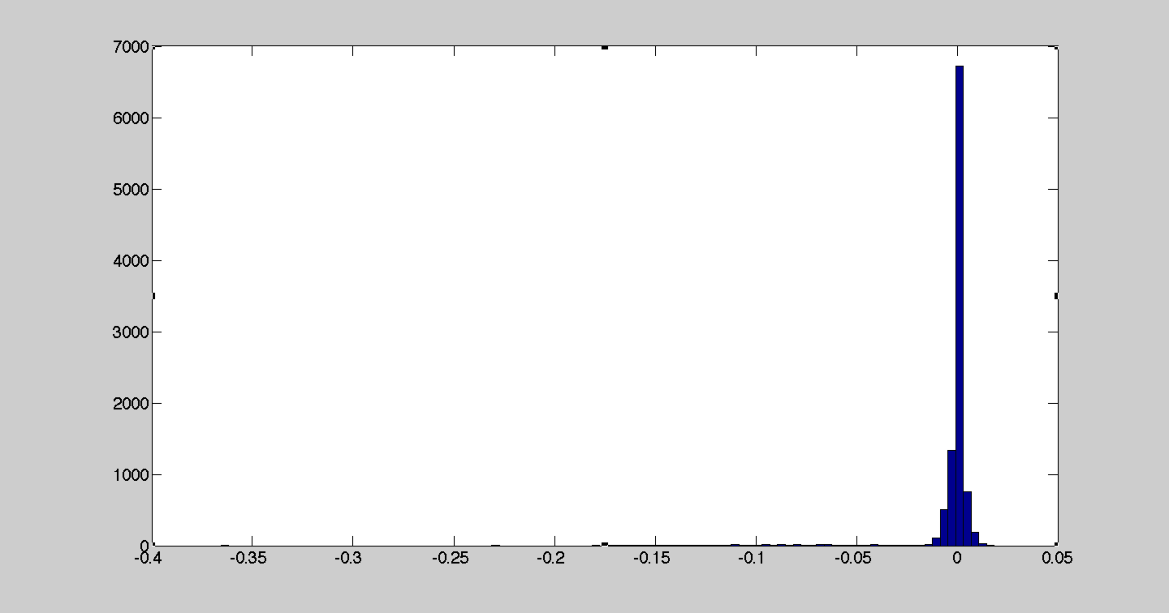
INCORRECT IMPLEMENTATION (3-MATERIAL PV)
T=10,000
N=10,000
H₀ can be rejected!
Histogram of ε for N=10,000, T=10,000

Slide 14
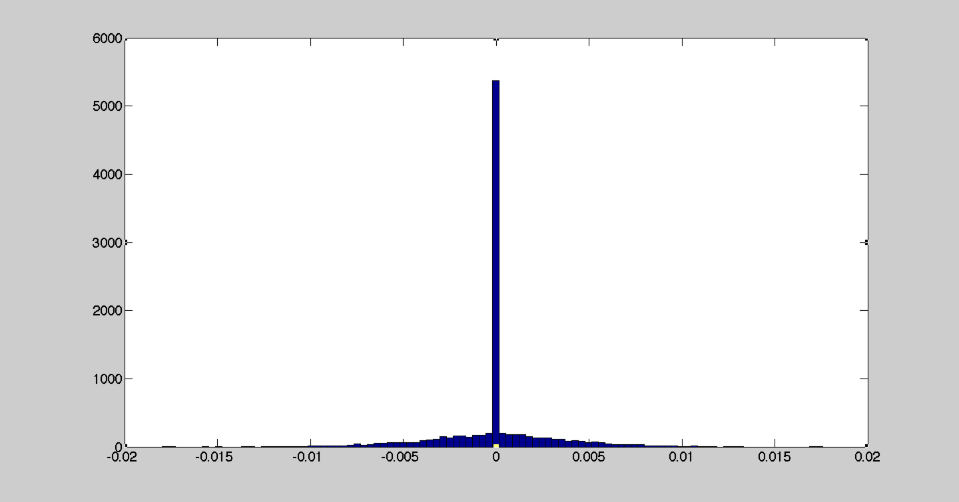
CORRECT IMPLEMENTATION (3-MATERIAL PV)
T=10,000
N=10,000
H₀ cannot be rejected!
Histogram of ε for N=10,000, T=10,000

Slide 15
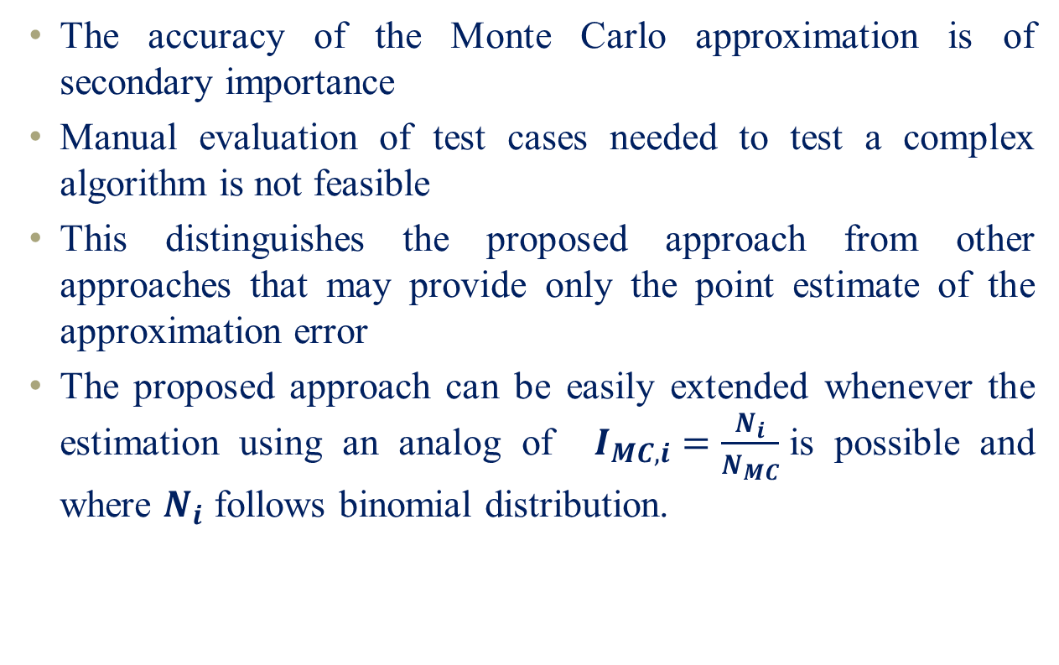
DISCUSSION AND CONCLUSIONS
The accuracy of the Monte Carlo approximation is of secondary importance
Manual evaluation of test cases needed to test a complex algorithm is not feasible
This distinguishes the proposed approach from other approaches that may provide only the point estimate of the approximation error
The proposed approach can be easily extended whenever the estimation using an analog of $I_{MC,i}=\frac{N_{i}}{N_{MC}}$is possible and where $N_{i}$ follows binomial distribution.

Slide 16
ACKNOWLEDGEMENTS
David D. Pokrajac
Associate Dean of Research & Analytics
Delaware State University
Predrag R. Bakic
Associate Professor of Radiology
University of Pennsylvania
Alton Thompson
Provost and Executive Vice President for Academic Affairs Delaware State University
Department of Computer & Information Sciences
Delaware State university

Slide 17
Thanks

